Slide 1

Enhancing Memory Management in Operating System for Improved Efficiency
Guided By:
Dr E.K Subramanian
(CourseFaculty)
Operating systems
Saveetha School Of Engineering
Project By:
N.Chaitanya Sai Raghu(192210380)
R.V.Bhargava Dileep(192210452)
M.Sri Ram(192210003)
Computer Science & Engineering
Saveetha School Of Engineering

Slide 2
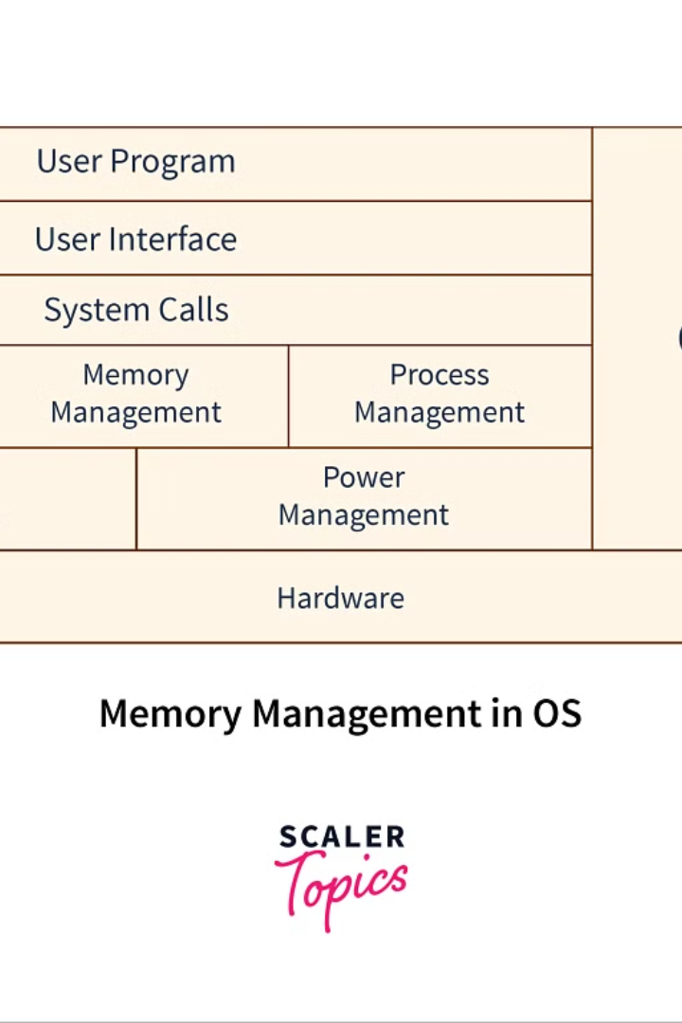
Aim
In the realm of operating systems, efficient memory management is a cornerstone of optimal system performance. The aim for superior memory management is to enhance the overall efficiency, speed, and stability of the system, ensuring that resources are utilized judiciously and potential bottlenecks are mitigated. It involves a careful balance of allocating, deallocating, and organizing memory, all while minimizing fragmentation and maximizing the availability of resources at any given time.
Effective memory management not only enhances the responsiveness of the system but also contributes to its reliability and robustness. By implementing advanced memory management techniques, operating systems can deliver seamless user experiences, enable the smooth execution of demanding applications, and facilitate multi-tasking without compromising on performance or stability.

Slide 3

Abstract
Memory management in operating systems is a crucial aspect that significantly impacts the overall system performance and efficiency. It involves various techniques and algorithms to optimize the utilization of the available memory resources, ensuring that each process receives the memory it needs. Efficient memory management not only enhances the speed and responsiveness of the system but also contributes to overall stability and reliability.
Furthermore, with the increasing complexity of modern applications and the growing demand for multi-tasking, the significance of robust memory management techniques has become even more pronounced. This abstract aims to delve into the key concepts, challenges, and advancements in memory management within operating systems, providing a comprehensive understanding of its pivotal role in ensuring optimal system functionality.

Slide 4
Objectives
Enhance memory allocation: Implement advanced algorithms to optimize memory allocation and reduce fragmentation.
Improve process scheduling: Enhance the scheduling of processes to efficiently utilize memory resources.
Enhance security: Implement memory protection and access control mechanisms to prevent unauthorized access to memory.

Slide 5

Problem Statements
1
Mismatched Memory Allocation
One of the primary issues in memory management is the mismatch between the requirements of a process and the allocation made by the operating system. This leads to inefficient utilization of memory resources and can result in performance bottlenecks.
2
Fragmentation Challenges
Fragmentation, both external and internal, poses a major challenge to memory management. It can lead to wastage of memory space and may require complex algorithms to defragment memory, impacting the overall efficiency of the system.
3
Lack of Real-Time Adaptability
The inability of many memory management systems to adapt in real-time to dynamic changes in memory requirements can hinder the system's responsiveness and performance. This is particularly critical in scenarios with varying workloads and resource demands.

Slide 6
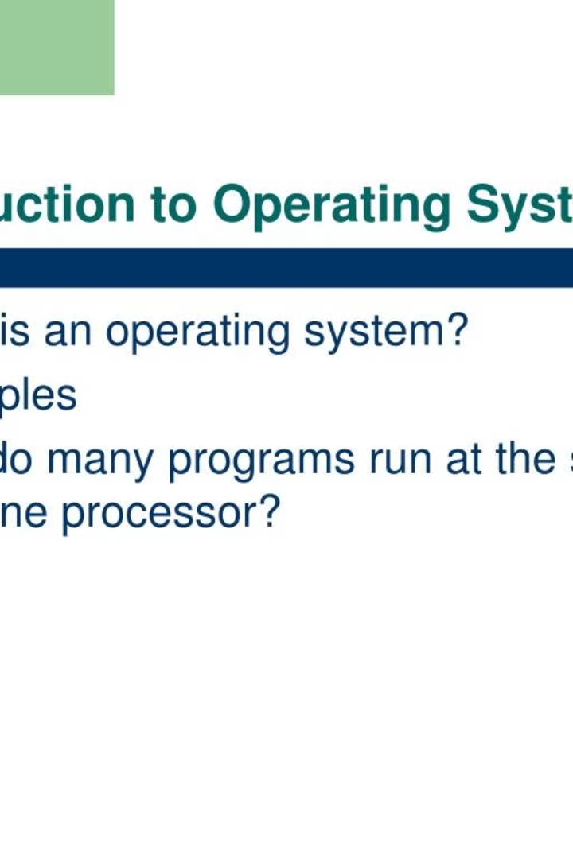
Introduction
The introduction to memory management in an operating system is crucial in understanding the fundamental principles of efficient resource allocation and optimization. It serves as the gateway to comprehending the intricate mechanisms that govern how data is stored, retrieved, and processed in a computing environment. From the early days of computing to the modern, multifaceted systems, the evolution of memory management has been pivotal in shaping the capabilities of operating systems. In this section, we delve into the historical context, core concepts, and the pivotal role of memory management in contemporary computing.
Understanding the intricacies of memory management provides a foundational base for comprehending the various strategies and techniques employed to enhance system performance and reliability. Moreover, it sheds light on the challenges and complexities associated with optimizing memory usage, thereby setting the stage for the exploration of innovative solutions and advancements in this critical domain.

Slide 7
Explanation
Memory Management Overview
Memory Segmentation and Paging
Dynamic Memory Allocation
Memory management in the operating system is a critical functionality that involves managing and coordinating computer memory. This process is essential for ensuring that the computer's resources are allocated efficiently to meet the demands of running programs and processes. The memory manager carries out tasks such as tracking each byte of memory, determining its use, and allocating or deallocating memory as needed. It also plays a crucial role in preventing memory leaks, optimizing RAM usage, and facilitating smooth multitasking.
The memory management system employs various techniques such as memory segmentation and paging to efficiently handle memory allocation and access. Memory segmentation divides the physical memory into logically independent address spaces for different processes, while paging involves breaking the physical memory into fixed-sized blocks, enabling efficient allocation and swapping of memory pages. These techniques are vital for optimizing memory usage and mitigating fragmentation.
Dynamic memory allocation is a key aspect of memory management that involves allocating memory at runtime to accommodate varying program requirements. It allows programs to request memory dynamically at execution time and release it once it’s no longer needed. Efficient dynamic memory allocation is crucial for preventing memory wastage and enhancing overall system performance.

Slide 8
Future Scope
Enhanced Memory Allocation Algorithms
Integration of Machine Learning
Future memory management systems may leverage machine learning algorithms to predict memory usage patterns and proactively allocate resources, enhancing overall system performance and reliability.
In the future, advancements in memory management may lead to the development of more efficient memory allocation algorithms that can dynamically adjust to changing workloads, resulting in optimized memory utilization.
Real-time Memory Optimization
Adaptive Memory Compression
With evolving technologies, future memory management solutions may enable real-time dynamic memory optimization, ensuring that critical applications receive the required memory resources for seamless operation.
Potential future developments may include adaptive memory compression techniques, allowing for efficient usage of memory space and facilitating the management of large data sets with reduced overhead.

Slide 9
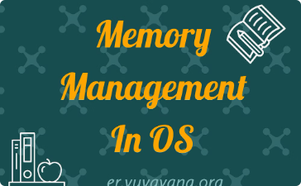
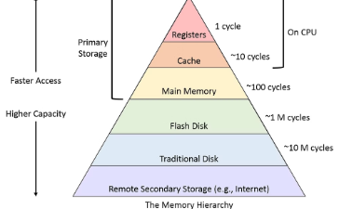
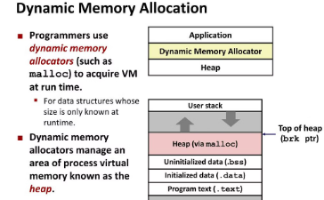
Results
Improved System Performance
Resource Utilization Optimization
Minimized Memory Leaks
The enhanced memory management in the operating system has resulted in a significant improvement in overall system performance. With faster access to data and optimized memory allocation, processes can execute more efficiently, leading to a noticeable boost in productivity and response times.
By implementing advanced memory management techniques, the operating system has been able to optimize resource utilization, effectively reducing wastage and enhancing overall system efficiency. This has led to a more balanced distribution of resources, avoiding bottlenecks and improving overall system stability.
The improved memory allocation and management strategies have successfully minimized instances of memory leaks, resulting in a more stable and reliable system. This has led to a reduction in system crashes and unexpected errors, providing a smoother and more dependable user experience.

Slide 10

Literature Survey
Research Papers
Case Studies
The literature survey involves an extensive analysis of research papers published in reputable journals and conference proceedings. These papers provide insights into existing memory management techniques, algorithms, and strategies implemented in various operating systems. They also shed light on the effectiveness, limitations, and potential areas of improvement in current memory management systems.
Additionally, case studies from real-world implementations of memory management solutions are studied. These provide valuable practical examples of how memory management techniques have been applied in different scenarios, the challenges encountered, and the outcomes achieved. This helps in understanding the real-world implications and practical considerations in memory management.
Books and Publications
Furthermore, literature review encompasses studying books and publications authored by experts in the field of operating systems and memory management. These resources offer in-depth theoretical knowledge, historical perspectives, and cutting-edge advancements in memory management, providing a comprehensive understanding of the subject.

Slide 11

Conclusion
After a comprehensive exploration of memory management in operating systems, it is evident that effective memory utilization is pivotal for enhancing system performance and efficiency. By addressing the identified challenges and seizing the opportunities presented by advancements in memory technology, the potential for improved system reliability, speed, and overall productivity becomes increasingly promising.
Furthermore, the conclusions drawn from the study underscore the critical role of memory management in shaping the future landscape of operating systems. Embracing innovative approaches and technologies can substantially contribute to addressing the evolving demands of modern computing environments, thus establishing a solid foundation for the continuous evolution of memory management strategies in operating systems.

Slide 12
Thank You!

